Slide 1
AER 1216 – Fundamentals of UAVs
Lecture 12 - Quadrotor Dynamics and Control II
Karime Pereida, Ph.D.
Prof. Angela Schoellig

Slide 2
Quadrotor Dynamics and Control I
Motivation
Quadrotors require controllers to work well
How does a quadrotor move?
Varying motor speeds
What is the quadrotor control architecture?
Nested control architecture
How to control a 1D quadrotor?
PD controller for a 1D quadrotor
Simulator and initial control exploration

Slide 3
Quadrotor Dynamics and Control Lectures
Lecture 1 | Lecture 2 | Lecture 3
Introduction to quadrotor control Controlling the up-down motion of the quadrotor | Controlling the quadrotor in 2D (y-z plane) Introduction to nonlinear controllers | Controlling the quadrotor in 3D Setting up a commercially available quadrotor
Installing simulator and initial controller exploration | Applying a 2D controller to the simulated quadrotor | How to set up a commercially available quadrotor
Inspired by Vijay Kumar’s Aerial Robotics Coursera course https://www.coursera.org/learn/robotics-flight

Slide 4
Quadrotor Dynamics and Control II
How to linearly control a planar (2D) quadrotor?
Planar (2D) quadrotor model
Linearization
Nested control loop
What other linear controllers can we use?
When should we use nonlinear controllers?
How to nonlinearly control a planar (2D) quadrotor?
How to control the planar quadrotor in simulation?

Slide 5
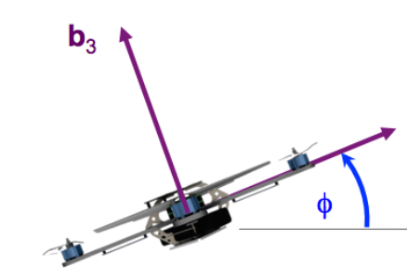
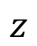
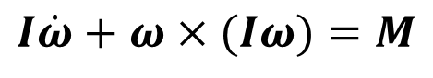
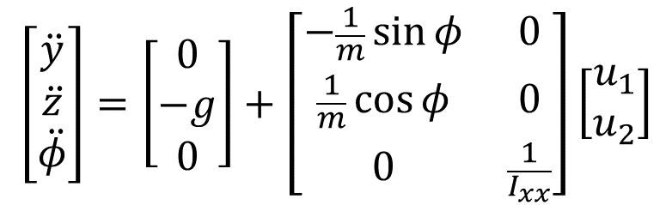
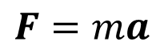
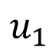
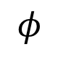
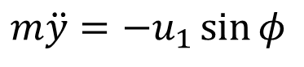
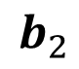
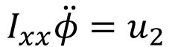
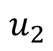
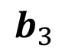
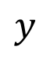
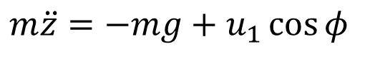
Planar (2D) Quadrotor Model
$$b_{3}$$
$$\left[\begin{matrix}\ddot{y} \\ \ddot{z} \\ \ddot{φ}\end{matrix}\right]=\left[\begin{matrix}0 \\ −g \\ 0\end{matrix}\right]+\left[\begin{matrix}−\frac{1}{m}\sin{φ} & 0 \\ \frac{1}{m}\cos{φ} & 0 \\ 0 & \frac{1}{I_{xx}}\end{matrix}\right]\left[\begin{matrix}u_{1} \\ u_{2}\end{matrix}\right]$$
Thrust
$$z$$
$$b_{2}$$
$$u_{1}$$
Moment
$$φ$$
$$u_{2}$$
$$y$$
$m\ddot{y}=−u_{1}\sin{φ}$
Newton’s equations of motion:
$$F=ma$$
$m\ddot{z}=−mg+u_{1}\cos{φ}$
Euler’s equations of motion:
$$I\dot{ω}+ω×(Iω)=M$$
$$I_{xx}\ddot{φ}=u_{2}$$

Slide 6
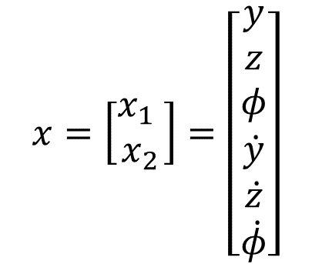
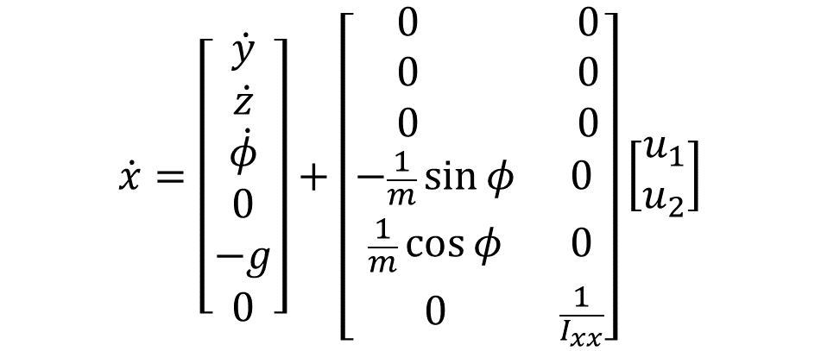
Planar (2D) Quadrotor Model
$$b_{3}$$
$$\left[\begin{matrix}\ddot{y} \\ \ddot{z} \\ \ddot{φ}\end{matrix}\right]=\left[\begin{matrix}0 \\ −g \\ 0\end{matrix}\right]+\left[\begin{matrix}−\frac{1}{m}\sin{φ} & 0 \\ \frac{1}{m}\cos{φ} & 0 \\ 0 & \frac{1}{I_{xx}}\end{matrix}\right]\left[\begin{matrix}u_{1} \\ u_{2}\end{matrix}\right]$$
Thrust
$$z$$
$$b_{2}$$
$$u_{1}$$
Moment
$$φ$$
$$u_{2}$$
$$\dot{x}=\left[\begin{matrix}\begin{matrix}\dot{y} \\ \dot{z} \\ \dot{φ}\end{matrix} \\ \begin{matrix}0 \\ −g \\ 0\end{matrix}\end{matrix}\right]+\left[\begin{matrix}\begin{matrix} 0 & 0 \\ 0 & 0 \\ 0 & 0\end{matrix} \\ \begin{matrix}−\frac{1}{m}\sin{φ} & 0 \\ \frac{1}{m}\cos{φ} & 0 \\ 0 & \frac{1}{I_{xx}}\end{matrix}\end{matrix}\right]\left[\begin{matrix}u_{1} \\ u_{2}\end{matrix}\right]$$
$$y$$
$$x=\left[\begin{matrix}x_{1} \\ x_{2}\end{matrix}\right]=\left[\begin{matrix}\begin{matrix}y \\ z \\ φ\end{matrix} \\ \begin{matrix}\dot{y} \\ \dot{z} \\ \dot{φ}\end{matrix}\end{matrix}\right]$$
State space:

Slide 7
Quadrotor Dynamics and Control II
How to linearly control a planar (2D) quadrotor?
Planar (2D) quadrotor model
Linearization
Nested control loop
What other linear controllers can we use?
When should we use nonlinear controllers?
How to nonlinearly control a planar (2D) quadrotor?
How to control the planar quadrotor in simulation?

Slide 8
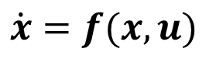
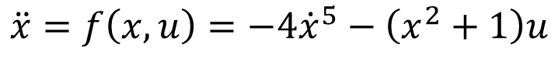
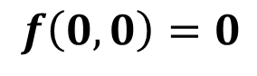
Linearization
Helps us to control nonlinear systems around equilibrium points.
Insight of stability around equilibrium points (Lyapunov linearization method).
For nonlinear systems of the following form: with equilibrium point .
Use Taylor first-order expansion:
E.g.,
Equilibrium point:
Linearization through Taylor expansion:
$$\dot{x}=f(x,u)$$
$$f\left(0,0\right)=0$$
$$\dot{x}=\frac{∂}{∂x}f\left(x,u\right){\left.​\right|}_{\left(x_{0},u_{0}\right)}\left(x−x_{0}\right) +\frac{∂}{∂u}f\left(x,u\right){\left.​\right|}_{\left(x_{0},u_{0}\right)}\left(u−u_{0}\right)$$
$$\ddot{x}=f\left(x, u\right)=−4{\dot{x}}^{5}−\left(x^{2}+1\right)u$$
$$\ddot{x}=−4{\dot{x}}^{5}−\left(x^{2}+1\right)u=0 →{\dot{x}}_{0}=0, x_{0}=0, u_{0}=0$$
$$\ddot{x}=−20{\dot{x}}_{0}^{4}\left(\dot{x}−{\dot{x}}_{0}\right)−2x_{0}u_{0}\left(x−x_{0}\right)−1\left(u−u_{0}\right)=−u$$

Slide 9
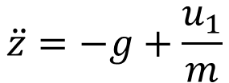
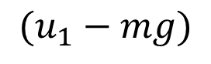
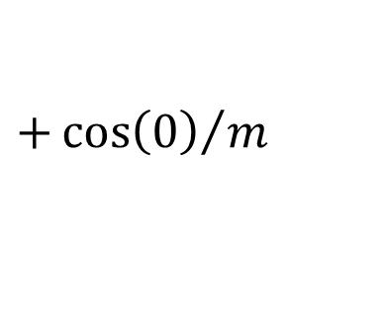
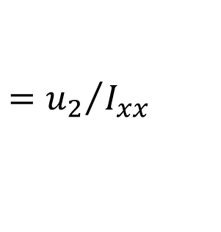
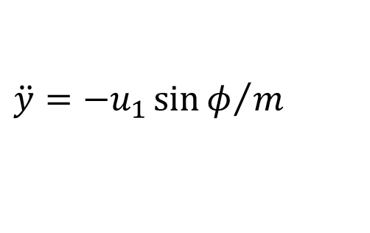

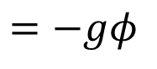
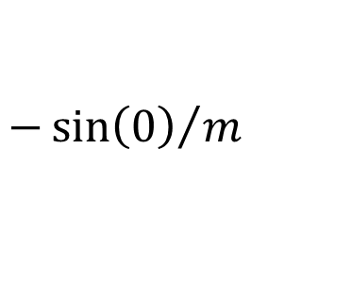
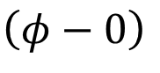
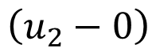
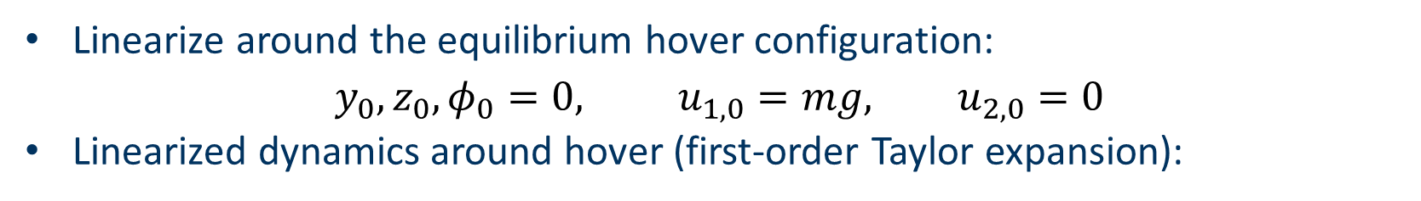
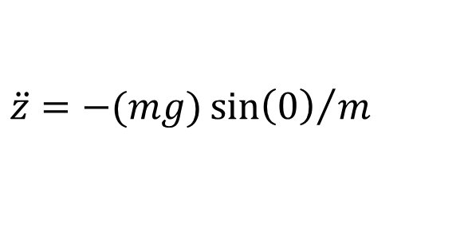
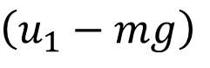
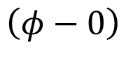
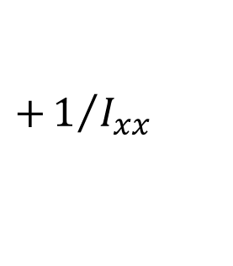
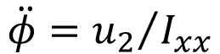

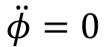
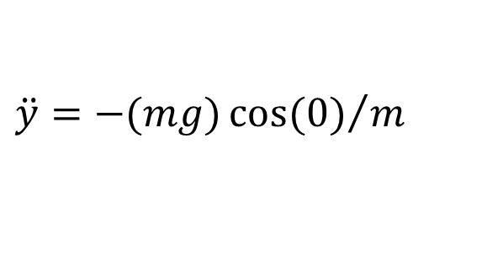
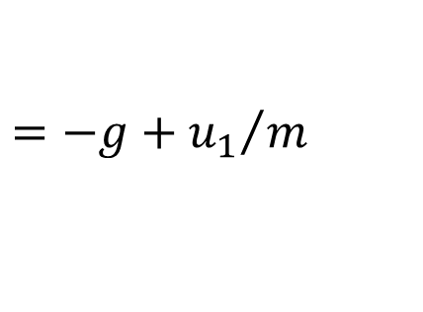
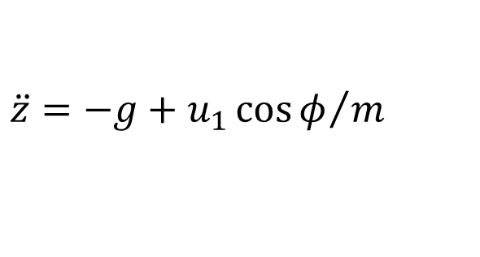
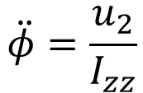


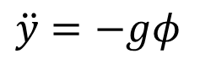
Linearized Dynamics Model
Nonlinear equations of motion:
$$\ddot{y}={−u_{1}\sin{φ}}/m$$
$$\ddot{φ}={u_{2}}/{I_{xx}}$$
$$\ddot{z}=−g+{u_{1}\cos{φ}}/m$$
Linearize around the equilibrium hover configuration:
$$y_{0},z_{0},φ_{0}=0, u_{1,0}=mg, u_{2,0}=0$$
Linearized dynamics around hover (first-order Taylor expansion):
$$\dot{x}=\frac{∂}{∂x}f\left(x,u\right){\left.​\right|}_{\left(x_{0},u_{0}\right)}\left(x−x_{0}\right)+\frac{∂}{∂u}f\left(x,u\right){\left.​\right|}_{\left(x_{0},u_{0}\right)}\left(u−u_{0}\right)$$
$$1$$
$$0$$
$$\ddot{y}={−(mg)\cos{(0)}}/m$$
$$\left(φ−0\right)$$
$$−{\sin\left(0\right)}/m$$
$(u_{1}−mg)$
$$=−gφ$$
$$\ddot{y}=−gφ$$
$$0$$
$$1$$
$$\ddot{z}={−(mg)\sin\left(0\right)}/m$$
$$\left(φ−0\right)$$
$$+{\cos\left(0\right)}/m$$
$$\left(u_{1}−mg\right)$$
$$=−g+{u_{1}}/m$$
$$\ddot{z}=−g+\frac{u_{1}}{m}$$
$$\ddot{φ}=\frac{u_{2}}{I_{zz}}$$
$$\ddot{φ}=0$$
$$+1/{I_{xx}}$$
$$\left(u_{2}−0\right)$$
$$={u_{2}}/{I_{xx}}$$

Slide 10
Quadrotor Dynamics and Control II
How to linearly control a planar (2D) quadrotor?
Planar (2D) quadrotor model
Linearization
Nested control loop
What other linear controllers can we use?
When should we use nonlinear controllers?
How to nonlinearly control a planar (2D) quadrotor?
How to control the planar quadrotor in simulation?

Slide 11
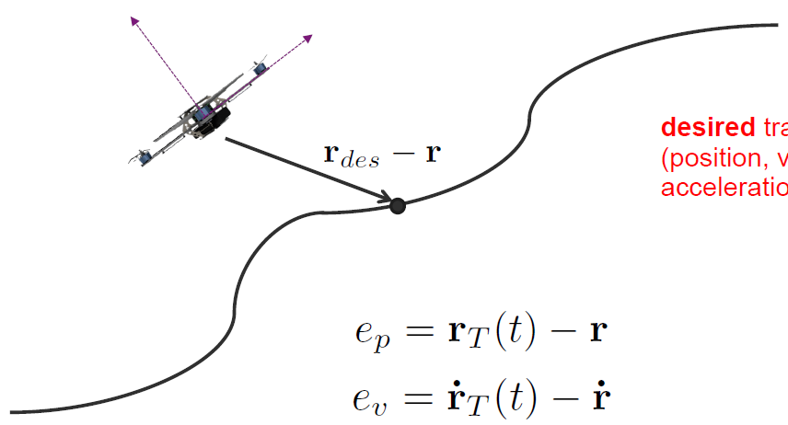
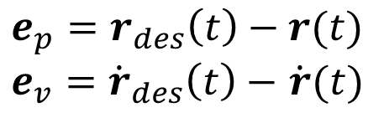
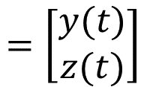
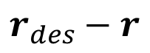
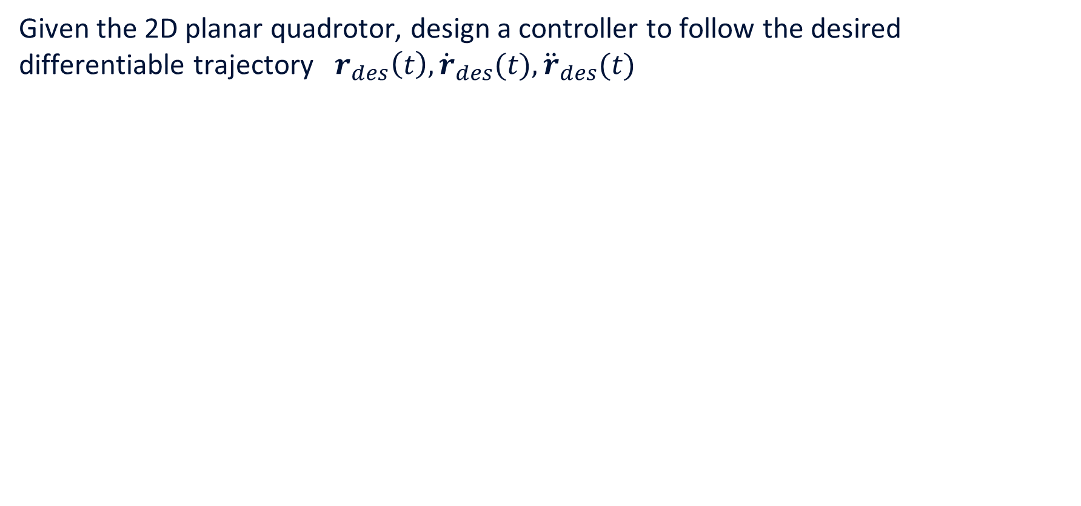
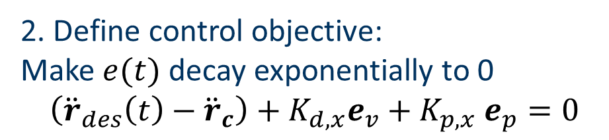
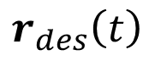
2D Trajectory Tracking Problem Statement
Given the 2D planar quadrotor, design a controller to follow the desired differentiable trajectory $r_{des}\left(t\right), {\dot{r}}_{des}(t), {\ddot{r}}_{des}(t)$
$$=\left[\begin{matrix}y(t) \\ z(t)\end{matrix}\right]$$
$$r_{des}\left(t\right)$$
1. Define error:
$$e_{p}=r_{des}\left(t\right)−r(t)$$
$e_{v}={\dot{r}}_{des}\left(t\right)−$ $\dot{r}(t)$
$$r_{des}−r$$
Desired trajectory
(pos., vel., accel.)
2. Define control objective:
Make $e(t)$ decay exponentially to 0
$$\left({\ddot{r}}_{des}\left(t\right)−{\ddot{r}}_{c}\right)+K_{d,x}e_{v}+K_{p,x} e_{p}=0$$
3. Choose appropriate controller.

Slide 12
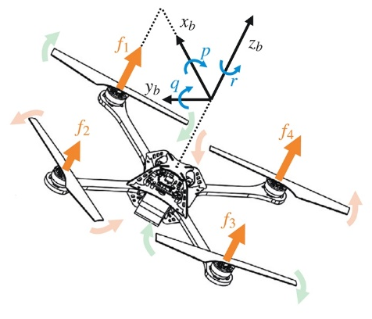
Nested Control Architecture
Cost
Function
Motion
Position
+ Yaw
Angles + angular rates
Moment
Thrust
High-Level Task
High-level Objective
Position Ctrl
Attitude Ctrl
Motor Ctrl
Features
Position + Yaw
Angle and angular rates
Meas./Estimates
Measured Turn Rates
Assume that yaw is controlled to a constant value
We focus on calculating thrust and moment (motor control is typically proportional)

Slide 13
Nested Control Architecture
Angles + angular rates
Motion
Moment
Attitude Ctrl
Angle and angular rates
Meas./Estimates

Slide 14
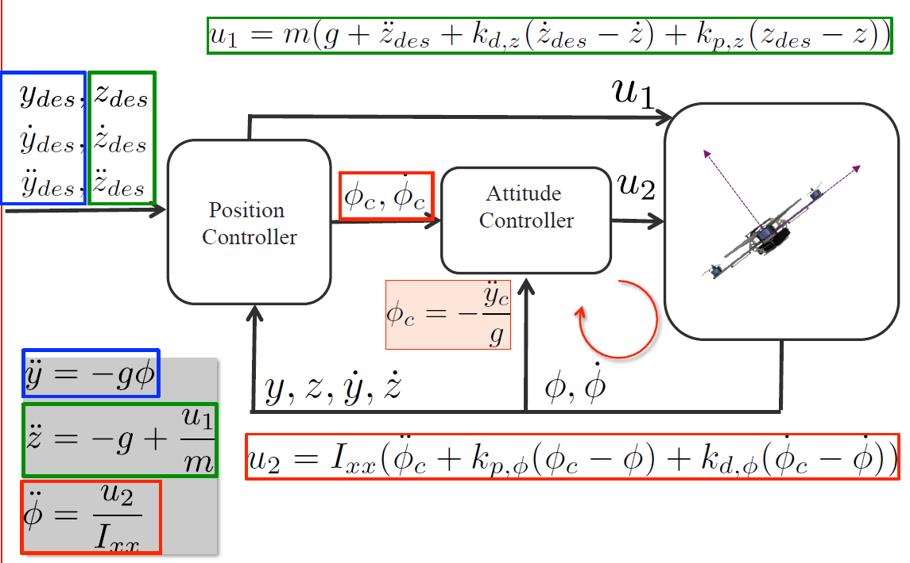
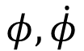




Attitude Controller
Make $e=φ_{c}−φ$ decay exponentially to 0:
$$\left({\ddot{φ}}_{c}−\ddot{φ}\right)+k_{p,φ}\left(φ_{c}−φ\right)+k_{d,φ}\left({\dot{φ}}_{c}−\dot{φ}\right)=0$$
$$\ddot{φ}={\ddot{φ}}_{c}+k_{p,φ}\left(φ_{c}−φ\right)+k_{d,φ}\left({\dot{φ}}_{c}−\dot{φ}\right)$$
$$φ_{c}, {\dot{φ}}_{c}$$
Attitude
Controller
$$u_{2}$$
Linearized dynamics:
$$φ,\dot{φ}$$
$$\ddot{φ}=\frac{u_{2}}{I_{xx}}$$
$$u_{2}=I_{xx}({\ddot{φ}}_{c}+k_{p,φ}\left(φ_{c}−φ\right)+k_{d,φ}({\dot{φ}}_{c}−\dot{φ}))$$
Notes:
Focus on the attitude controller. U2 s.t. phi (differentiable) goes to the desired value.
Look at equations of motion. Relate u2 and phi.
Relate phi and ydd.

Slide 15
Nested Control Architecture
Position
+ Yaw
Angles + angular rates
Motion
Moment
Position Ctrl
Attitude Ctrl
Position + Yaw
Angle and angular rates
Meas./Estimates

Slide 16








Position Controller
Make $e=y_{des}−y$ decay exponentially to 0:
$$\left({\ddot{y}}_{des}−\ddot{y}\right)+k_{p,y}\left(y_{des}−y\right)+k_{d,y}\left({\dot{y}}_{des}−\dot{y}\right)=0$$
Shape $φ_{c}$ as a first-order system:
$${\dot{φ}}_{c}=\frac{1}{τ_{φ_{c}}}\left(φ_{c}−φ\right)$$
$$\ddot{y}={\ddot{y}}_{des}+k_{p,y}\left(y_{des}−y\right)+k_{d,y}\left({\dot{y}}_{des}−\dot{y}\right)$$
$$y_{des},z_{des}$$
$${\dot{y}}_{des},{\dot{z}}_{des}$$
$${\ddot{y}}_{des},{\ddot{z}}_{des}$$
Position
Controller
$$φ_{c}, {\dot{φ}}_{c}$$
Attitude
Controller
$$u_{2}$$
Linearized dynamics:
$$φ_{c}=−\frac{\ddot{y}}{g}$$
$$\ddot{y}=−gφ$$
$$y,z,\dot{y},\dot{z}$$
$$φ,\dot{φ}$$
$$\ddot{φ}=\frac{u_{2}}{I_{xx}}$$
$$φ_{c}=−\frac{1}{g}({\ddot{y}}_{des}+k_{p,y}\left(y_{des}−y\right)+k_{d,y}\left({\dot{y}}_{des}−\dot{y}\right))$$
Notes:
Focus on the attitude controller. U2 s.t. phi (differentiable) goes to the desired value.
Look at equations of motion. Relate u2 and phi.
Relate phi and ydd.

Slide 17
Nested Control Architecture
Thrust
Position
+ Yaw
Angles + angular rates
Motion
Moment
Position Ctrl
Attitude Ctrl
Position + Yaw
Angle and angular rates
Meas./Estimates

Slide 18



Position Controller
Make $e=z_{des}−z$ decay exponentially to 0:
$$\left({\ddot{z}}_{des}−\ddot{z}\right)+k_{p,z}\left(z_{des}−z\right)+k_{d,z}\left({\dot{z}}_{des}−\dot{z}\right)=0$$
$$\ddot{z}={\ddot{z}}_{des}+k_{p,z}\left(z_{des}−z\right)+k_{d,z}\left({\dot{z}}_{des}−\dot{z}\right)$$
$$u_{1}$$
$$y_{des},z_{des}$$
$${\dot{y}}_{des},{\dot{z}}_{des}$$
$${\ddot{y}}_{des},{\ddot{z}}_{des}$$
Position
Controller
$$φ_{c}, {\dot{φ}}_{c}$$
Attitude
Controller
$$u_{2}$$
Linearized dynamics:
$$\ddot{y}=−gφ$$
$$\ddot{z}=−g+\frac{u_{1}}{m}$$
$$y,z,\dot{y},\dot{z}$$
$$φ,\dot{φ}$$
$$\ddot{φ}=\frac{u_{2}}{I_{xx}}$$
$$u_{1}=m(g+{\ddot{z}}_{des}+k_{p,z}\left(z_{des}−z\right)+k_{d,z}\left({\dot{z}}_{des}−\dot{z}\right))$$
Notes:
Focus on the attitude controller. U2 s.t. phi (differentiable) goes to the desired value.
Look at equations of motion. Relate u2 and phi.
Relate phi and ydd.

Slide 19

Nested Control Architecture
Cost
Function
Motion
Position
+ Yaw
Angles + angular rates
Moment
Thrust
High-Level Task
High-level Objective
Position Ctrl
Attitude Ctrl
Motor Ctrl
Features
Position + Yaw
Angle and angular rates
Meas./Estimates
Measured Turn Rates
$$u_{1}=m(g+{\ddot{z}}_{des}+k_{p,z}\left(z_{des}−z\right)+k_{d,z}\left({\dot{z}}_{des}−\dot{z}\right))$$
$${\dot{φ}}_{c}=\frac{1}{τ_{φ_{c}}}\left(φ_{c}−φ\right)$$
$$u_{2}=I_{xx}({\ddot{φ}}_{c}+k_{p,φ}\left(φ_{c}−φ\right)+k_{d,φ}({\dot{φ}}_{c}−\dot{φ}))$$
$$φ_{c}=−\frac{1}{g}({\ddot{y}}_{des}+k_{p,y}\left(y_{des}−y\right)+k_{d,y}\left({\dot{y}}_{des}−\dot{y}\right))$$

Slide 20

Control Equations
$$u_{1}=m(g+{\ddot{z}}_{des}+k_{d,z}\left({\dot{z}}_{des}−\dot{z}\right)+k_{p,z}(z_{des}−z))$$
$$u_{2}=I_{xx}({\ddot{φ}}_{c}+k_{p,φ}\left(φ_{c}−φ\right)+k_{d,φ}({\dot{φ}}_{c}−\dot{φ}))$$
$$u_{2}=I_{xx}(k_{p,φ}\left(φ_{c}−φ\right)+k_{d,φ}\left({\dot{φ}}_{c}−\dot{φ}\right))$$
$$φ_{c}=−\frac{1}{g}({\ddot{y}}_{des}+k_{d,y} \left({\dot{y}}_{des}−\dot{y}\right)+k_{p,y}(y_{des}−y)$$
Simplification with no performance reduction
Notes:
Focus on the attitude controller. U2 s.t. phi (differentiable) goes to the desired value.
Look at equations of motion. Relate u2 and phi.
Relate phi and ydd.

Slide 21

Control Equations
$$u_{1}=m(g+{\ddot{z}}_{des}+k_{d,z}\left({\dot{z}}_{des}−\dot{z}\right)+k_{p,z}(z_{des}−z))$$
$$u_{2}=I_{xx}(k_{p,φ}\left(φ_{c}−φ\right)+k_{d,φ}\left({\dot{φ}}_{c}−\dot{φ}\right))$$
$$φ_{c}=−\frac{1}{g}({\ddot{y}}_{des}+k_{d,y} \left({\dot{y}}_{des}−\dot{y}\right)+k_{p,y}(y_{des}−y)$$
Notes:
Focus on the attitude controller. U2 s.t. phi (differentiable) goes to the desired value.
Look at equations of motion. Relate u2 and phi.
Relate phi and ydd.

Slide 22
Quadrotor Dynamics and Control II
How to linearly control a planar (2D) quadrotor?
What other linear controllers can we use?
Pole placement
Linear Quadratic Regulator (LQR)
When should we use nonlinear controllers?
How to nonlinearly control a planar (2D) quadrotor?
How to control the planar quadrotor in simulation?

Slide 23













Linear Controllers
Pole placement:
Consider the linearized dynamics of our system:
The closed-loop system for input $u=−Fx$ is given by:
If the pair $(A,B)$ is controllable (input can move the state from any initial state to any final state in finite time), then there exists a feedback matrix $F$ such that the closed-loop eigenvalues can be placed in arbitrary locations.
$$\left[\begin{matrix}\begin{matrix}\dot{y} \\ \dot{z} \\ \dot{φ}\end{matrix} \\ \begin{matrix}\ddot{y} \\ \ddot{z} \\ \ddot{φ}\end{matrix}\end{matrix}\right]=\left[\begin{matrix}\begin{matrix}0 & 0 & 0 \\ 0 & 0 & 0 \\ 0 & 0 & 0\end{matrix} & \begin{matrix}1 & 0 & 0 \\ 0 & 1 & 0 \\ 0 & 0 & 1\end{matrix} \\ \begin{matrix}0 & 0 & −g \\ 0 & 0 & 0 \\ 0 & 0 & 0\end{matrix} & \begin{matrix}0 & 0 & 0 \\ 0 & 0 & 0 \\ 0 & 0 & 0\end{matrix}\end{matrix}\right]\left[\begin{matrix}\begin{matrix}y \\ z \\ φ\end{matrix} \\ \begin{matrix}\dot{y} \\ \dot{z} \\ \dot{φ}\end{matrix}\end{matrix}\right]+\left[\begin{matrix}\begin{matrix}0 & 0 \\ 0 & 0 \\ 0 & 0\end{matrix} \\ \begin{matrix}0 & 0 \\ 1/m & 0 \\ 0 & 1/{I_{xx}}\end{matrix}\end{matrix}\right]\left[\begin{matrix}u_{1}−mg \\ u_{2}\end{matrix}\right]$$
$$\ddot{y}=−gφ$$
$$\ddot{z}=−g+\frac{u_{1}}{m}$$
$$\ddot{φ}=\frac{u_{2}}{I_{zz}}$$
$$\dot{x}$$
$$=$$
$$A$$
$$x$$
$$+$$
$$B$$
$$u$$
$$\dot{x}=\left(A−BF\right)x$$
We can choose the behavior of the closed-loop system
Where to place the eigenvalues?
Notes:
A = np.array([[0, 0, 0, 1, 0, 0], [0, 0, 0, 0, 1, 0], [0, 0, 0, 0, 0, 1], [0, 0, -self.g, 0, 0, 0], [0, 0, 0, 0, 0, 0], [0, 0, 0, 0, 0, 0]]) B = np.array([[0, 0], [0, 0], [0, 0], [0, 0], [1/self.mass, 0], [0, 1/self.inertia_xx]]) cont = np.concatenate((B, A.dot(B), A.dot(A.dot(B)), A.dot(A.dot(A.dot(B))), A.dot(A.dot(A.dot(A.dot(B)))), A.dot(A.dot(A.dot(A.dot(A.dot(B))))) ), axis=1)

Slide 24
Quadrotor Dynamics and Control II
How to linearly control a planar (2D) quadrotor?
What other linear controllers can we use?
Pole placement
Linear Quadratic Regulator (LQR)
When should we use nonlinear controllers?
How to nonlinearly control a planar (2D) quadrotor?
How to control the planar quadrotor in simulation?

Slide 25



Linear Controllers
Linear Quadratic Regulator (LQR):
Operate the dynamic system at a minimum cost. (Optimal control)
Cost is described by a quadratic function.
System described by set of linear differential equations.
For discrete-time systems:
Optimal control sequence minimizing cost is:
$$x_{k+1}=Ax_{k}+Bu_{k}$$
penalize error
$$J=\sum_{k=0}^{∞}{\left(x_{k}^{T}Qx_{k}+u_{k}^{T}Ru_{k}\right)}$$
penalize control effort
$$u_{k}=−Kx_{k}$$
static gain
Notes:
Focus on the attitude controller. U2 s.t. phi (differentiable) goes to the desired value.
Look at equations of motion. Relate u2 and phi.
Relate phi and ydd.

Slide 26
Q&A
Break

Slide 27
Quadrotor Dynamics and Control II
How to linearly control a planar (2D) quadrotor?
What other linear controllers can we use?
When should we use nonlinear controllers?
How to nonlinearly control a planar (2D) quadrotor?
How to control the planar quadrotor in simulation?

Slide 28

When should we use nonlinear controllers?
Which type of controller (linear/nonlinear) does each drone have?

Slide 29
When should we use nonlinear controllers?
The task was to fly at 1 m. However, one drone is not able to achieve this.
What type of controller does it have?

Slide 30





When should we use nonlinear controllers?
Why is this happening?
Linearization is neglecting the effect of the roll angle in the system thrust.
Nonlinear dynamics:
$$\ddot{y}={−u_{1}\sin{φ}}/m$$
$$\ddot{z}=−g+{u_{1}\cos{φ}}/m$$
Linearized dynamics:
$$\ddot{y}=−gφ$$
$$\ddot{z}=−g+\frac{u_{1}}{m}$$
In other words: modeling errors
Notes:
Focus on the attitude controller. U2 s.t. phi (differentiable) goes to the desired value.
Look at equations of motion. Relate u2 and phi.
Relate phi and ydd.

Slide 31


When should we use nonlinear controllers?
When we want to perform aggressive Maneuvers
Triple flip with a quadrotor
Time-optimized slalom
Fast path following with a ground vehicle
..
S. Schaal and C. G. Atkeson, “Learning control in robotics,”
IEEE Robotics & Automation Magazine, vol. 17, no. 2, pp. 20–29, 2010.
Notes:
That is, there is a computer that controls one or multiple robots at the same time. Specifically, I have been working with unmanned aerial vehicles for the past 6 years – these are so-called quadrocopters. They have four rotors that can be controlled separately and enable very agile, aggressive maneuvers.

Slide 32

Triple Adaptive Flips
youtu.be/bWExDW9J9sA

Slide 33

Slalom Learning
youtu.be/zHTCsSkmADo

Slide 34

Visual Teach and Repeat
youtu.be/08_d1HSPADA

Slide 35



When should we use nonlinear controllers?
Unmodelled dynamics
Unknown external disturbances
(e.g., environment conditions such as wind, unknown payload, topography or weather)
Model inaccuracies limit achievable performance!
Notes:
That is, there is a computer that controls one or multiple robots at the same time. Specifically, I have been working with unmanned aerial vehicles for the past 6 years – these are so-called quadrocopters. They have four rotors that can be controlled separately and enable very agile, aggressive maneuvers.

Slide 36
Nonlinear Controllers
Robust Control: controller is guaranteed to be stable for all possible realizations of the disturbance
Handles rapidly changing disturbances
Tends to be conservative
Adaptive Control: controller adapts based on parameters estimated using state measurements during execution
Slow-varying disturbances
Could present unwanted effects such as chattering
Disturbances include modeling errors
Notes:
A = np.array([[0, 0, 0, 1, 0, 0], [0, 0, 0, 0, 1, 0], [0, 0, 0, 0, 0, 1], [0, 0, -self.g, 0, 0, 0], [0, 0, 0, 0, 0, 0], [0, 0, 0, 0, 0, 0]]) B = np.array([[0, 0], [0, 0], [0, 0], [0, 0], [1/self.mass, 0], [0, 1/self.inertia_xx]]) cont = np.concatenate((B, A.dot(B), A.dot(A.dot(B)), A.dot(A.dot(A.dot(B))), A.dot(A.dot(A.dot(A.dot(B)))), A.dot(A.dot(A.dot(A.dot(A.dot(B))))) ), axis=1)

Slide 37
Nonlinear Controllers
Learning-based Control: controller improves performance by learning features (e.g. model) of the system
Performance can improve over time
Lack of stability guarantees
Optimal Control: controller optimizes the performance based on a predefined cost function
Performance depends on model quality
Could be computationally expensive
Controllers can be combined to improve their characteristics!
Disturbances include modeling errors
Notes:
A = np.array([[0, 0, 0, 1, 0, 0], [0, 0, 0, 0, 1, 0], [0, 0, 0, 0, 0, 1], [0, 0, -self.g, 0, 0, 0], [0, 0, 0, 0, 0, 0], [0, 0, 0, 0, 0, 0]]) B = np.array([[0, 0], [0, 0], [0, 0], [0, 0], [1/self.mass, 0], [0, 1/self.inertia_xx]]) cont = np.concatenate((B, A.dot(B), A.dot(A.dot(B)), A.dot(A.dot(A.dot(B))), A.dot(A.dot(A.dot(A.dot(B)))), A.dot(A.dot(A.dot(A.dot(A.dot(B))))) ), axis=1)

Slide 38
Learning and Adaptive Controllers
Learning and adaptation enable
safe, high-performance motions
in uncontrolled, unknown or changing environments

Slide 39
Research Focus
DYNAMICS
ROBOTICS
MACHINE LEARNING
CONTROLS
Prior information
Which motions are feasible?
How to plan collision-free motions?
+ Current sensor measurement
How to guide the vehicle along a desired path?
+ Past experiment data
Can the performance be improved by leveraging past data?
Towards robotics applications

Slide 40

Learning-based Robust Control
youtu.be/YqhLnCm0KXY

Slide 41


Development Process
Specific task, adaptation of a few input parameters only
General task, full input trajectory adaptation
Learning with safety guarantees
Model learning, anytime learning
True model
Nominal model

Slide 42
Importance of Nonlinear Controllers
Safe, reliable, high-performance flight of single or multiple aerial vehicles in changing and unknown conditions using a combination of a-priori models and data
DYNAMICS
ROBOTICS
MACHINE LEARNING
CONTROLS
Notes:
That is, there is a computer that controls one or multiple robots at the same time. Specifically, I have been working with unmanned aerial vehicles for the past 6 years – these are so-called quadrocopters. They have four rotors that can be controlled separately and enable very agile, aggressive maneuvers.

Slide 43
Quadrotor Dynamics and Control II
How to linearly control a planar (2D) quadrotor?
What other linear controllers can we use?
When should we use nonlinear controllers?
How to nonlinearly control a planar (2D) quadrotor?
How to control the planar quadrotor in simulation?

Slide 44




Nonlinear Controller 1
Nonlinear equations of motion:
We calculate $\ddot{y}, \ddot{z}$ such that the errors decay exponentially to 0.
Using $\ddot{z}$, the nonlinear equations of motion, and measured $φ$, we solve for $u_{1}$:
Using $\ddot{y}$, the nonlinear equations of motion, and $u_{1}$, we solve for $φ_{c}$:
Shape $φ_{c}$ as a first-order system:
$$\ddot{y}={−u_{1}\sin{φ}}/m$$
$$\ddot{φ}={u_{2}}/{I_{xx}}$$
$$\ddot{z}=−g+{u_{1}\cos{φ}}/m$$
$$u_{2}=I_{xx}(k_{p,φ}\left(φ_{c}−φ\right)+k_{d,φ}({\dot{φ}}_{c}−\dot{φ}))$$
$$\ddot{y}={\ddot{y}}_{des}+k_{p,y}\left(y_{des}−y\right)+k_{d,y}\left({\dot{y}}_{des}−\dot{y}\right)$$
$$\ddot{z}={\ddot{z}}_{des}+k_{p,z}\left(z_{des}−z\right)+k_{d,z}\left({\dot{z}}_{des}−\dot{z}\right)$$
$$u_{1}={m(\ddot{z}+g)}/{\cos{φ}}$$
$$φ_{c}=\sin^{−1}\left(\frac{−m\ddot{y}}{u_{1}}\right)$$
$${\dot{φ}}_{c}=\frac{1}{τ_{φ_{c}}}\left(φ_{c}−φ\right)$$

Slide 45






Nonlinear Controller 2
Nonlinear equations of motion:
We calculate $\ddot{y}, \ddot{z}$ such that the errors decay exponentially to 0.
We have a system of two equations and two unknowns $u_{1} , φ$. Solve for $u_{1}, φ_{c}$:
Shape $φ_{c}$ as a first-order system:
$$\ddot{y}={−u_{1}\sin{φ}}/m$$
$$\ddot{φ}={u_{2}}/{I_{xx}}$$
$$\ddot{z}=−g+{u_{1}\cos{φ}}/m$$
$$u_{2}=I_{xx}(k_{p,φ}\left(φ_{c}−φ\right)+k_{d,φ}({\dot{φ}}_{c}−\dot{φ}))$$
$$\ddot{y}={\ddot{y}}_{des}+k_{p,y}\left(y_{des}−y\right)+k_{d,y}\left({\dot{y}}_{des}−\dot{y}\right)$$
$$\ddot{z}={\ddot{z}}_{des}+k_{p,z}\left(z_{des}−z\right)+k_{d,z}\left({\dot{z}}_{des}−\dot{z}\right)$$
$${\ddot{y}}^{2}={{\left(−u_{1}\sin{φ}\right)}^{2}}/{m^{2}}$$
$${\left(\ddot{z}+g\right)}^{2}={{\left(u_{1}\cos{φ}\right)}^{2}}/{m^{2}}$$
$${{(\ddot{y}}^{2}+\left(\ddot{z}+g\right)}^{2})m^{2}=u_{1}^{2}$$
$$u_{1}=m\sqrt{{{(\ddot{y}}^{2}+\left(\ddot{z}+g\right)}^{2})}$$
$$φ_{c}=\sin^{−1}\left(\frac{−m\ddot{y}}{u_{1}}\right)$$
$${\dot{φ}}_{c}=\frac{1}{τ_{φ_{c}}}\left(φ_{c}−φ\right)$$

Slide 46
Quadrotor Dynamics and Control II
How to linearly control a planar (2D) quadrotor?
Linearize dynamics and apply PD controller
What other linear controllers can we use?
Pole placement and LQR
When should we use nonlinear controllers?
When system behavior deviates from linearization
How to nonlinearly control a planar (2D) quadrotor?
Nested architecture, nonlinear eq’s and measurements
How to control the planar quadrotor in simulation?

Slide 47
Q&A
Break

Slide 48
Quadrotor Dynamics and Control II
How to linearly control a planar (2D) quadrotor?
What other linear controllers can we use?
When should we use nonlinear controllers?
How to nonlinearly control a planar (2D) quadrotor?
How to control the planar quadrotor in simulation?

Slide 49






Quadrotor Frames
Please download the code at:
https://github.com/JacopoPan/gym-pybullet-drones/releases/tag/v0.5.2
Quadrotor reference frames:
$$M_{2}$$
$$M_{3}$$
$$M_{1}$$
$$y$$
$$M_{0}$$
$$x$$

Slide 50


Linear Controller
$$u_{1}=m(g+{\ddot{z}}_{des}+k_{d,z}\left({\dot{z}}_{des}−\dot{z}\right)+k_{p,z}(z_{des}−z))$$
$$u_{2}=I_{xx}(k_{p,φ}\left(φ_{c}−φ\right)+k_{d,φ}\left({\dot{φ}}_{c}−\dot{φ}\right))$$
$$φ_{c}=−\frac{1}{g}({\ddot{y}}_{des}+k_{d,y} \left({\dot{y}}_{des}−\dot{y}\right)+k_{p,y}(y_{des}−y)$$
Controller equations:
How to compute motor turn rates?
Hint 1: Think about sum of forces and torques
Hint 2: The quadrotor must move in the $y,z$ plane only without yaw movement.
Hint 3: How do the forces and moments relate to motor turn rates?

Slide 51












Linear vs Nonlinear Controller
Nonlinear controller 1 Nonlinear controller 2 Linear controller
$$u_{1}=m(g+{\ddot{z}}_{des}+k_{p,z}\left(z_{des}−z\right)+k_{d,z}\left({\dot{z}}_{des}−\dot{z}\right))$$
$$u_{1}={m(\ddot{z}+g)}/{\cos{φ}}$$
$$u_{1}=m\sqrt{{{(\ddot{y}}^{2}+\left(\ddot{z}+g\right)}^{2})}$$
$$u_{2}=I_{xx}(k_{p,φ}\left(φ_{c}−φ\right)+k_{d,φ}({\dot{φ}}_{c}−\dot{φ}))$$
$$u_{2}=I_{xx}(k_{p,φ}\left(φ_{c}−φ\right)+k_{d,φ}({\dot{φ}}_{c}−\dot{φ}))$$
$$u_{2}=I_{xx}(k_{p,φ}\left(φ_{c}−φ\right)+k_{d,φ}({\dot{φ}}_{c}−\dot{φ}))$$
$$φ_{c}=−\frac{1}{g}({\ddot{y}}_{des}+k_{p,y}\left(y_{des}−y\right)+k_{d,y}\left({\dot{y}}_{des}−\dot{y}\right))$$
$$φ_{c}=\sin^{−1}\left(\frac{−m\ddot{y}}{u_{1}}\right)$$
$$φ_{c}=\sin^{−1}\left(\frac{−m\ddot{y}}{u_{1}}\right)$$
$${\dot{φ}}_{c}=\frac{1}{τ_{φ_{c}}}\left(φ_{c}−φ\right)$$
$${\dot{φ}}_{c}=\frac{1}{τ_{φ_{c}}}\left(φ_{c}−φ\right)$$
$${\dot{φ}}_{c}=\frac{1}{τ_{φ_{c}}}\left(φ_{c}−φ\right)$$

Slide 52








Useful Variables and Functions
Variables:
Gravity: self.g
Quadrotor mass: self.mass
Quadrotor moment of inertia around x axis: self.inertia_xx
: y_ddot
: z_ddot
: roll_ddot
: current_rpy[0]
Basic math and NumPy:
: np.sin(x)
: np.cos(x)
: x**2
: np.sqrt(x)
$$\sin{φ}$$
$$\cos{φ}$$
$$x^{2}$$
$$\sqrt{x}$$
$$\ddot{y}$$
$$\ddot{z}$$
Modify the code at the four appropriate places denoted by
“Objective n of 4”.
$$\ddot{φ}$$
$$φ$$

Slide 53
Quadrotor Dynamics and Control II
How to linearly control a planar (2D) quadrotor?
Linearize dynamics and apply PD controller
What other linear controllers can we use?
Pole placement and LQR
When should we use nonlinear controllers?
When system behavior deviates from linearization
How to nonlinearly control a planar (2D) quadrotor?
Nested architecture, nonlinear eq’s and measurements
How to control the planar quadrotor in simulation?

